Slide 1
YELLOW ++ Project DEMO
Notes:
Who: Gay Stefan
Time: 40 sec

Slide 2
Disclaimer
This project is a student-created simulation for educational and entertainment purposes only. We are not affiliated with any government organization, nor does our work reflect actual government operations or policies. We are simply students exploring software design concepts—please don’t sue us!
Notes:
Who: Gay Stefan
Time: 40 sec

Slide 3
Content
Project Scope
Backend
Class Diagram
Design Patterns uses
Why and How
GitHub and Doxygen
Test
Conclusion
Live Demo
Notes:
Who: Stefan
Time: 40 sec

Slide 4
Project Scope
This project involves designing a City Builder Simulation in C++ that models sustainable urban management, covering elements like buildings, utilities, and transportation. Using design patterns for scalability and flexibility, we created UML diagrams, modular code, and detailed documentation, all while gaining collaborative coding experience with Git—preparing us for COS 301 and beyond
Notes:
Who: Saskia
Time: 30 sec

Slide 5
BAckend

Slide 6

Class Diagram
Notes:
Who: Raven
Time: 10 sec

Slide 7
Design Patterns Used
Memento
Prototype
Factory Method
Strategy
State
Composite
Observer
Command
Chain of Responsibility
Visitor
Singleton
Notes:
Who: Amadeus
Time: 40 sec

Slide 8
Memento
Utilized the Memento Design Pattern to develop an efficient save and load system.
Enabled users to revert to and continue from any previous state of the simulation.
Notes:
Who: Raven
Time: 30 sec

Slide 9
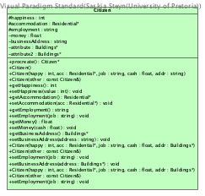
Prototype
Applied the Prototype Design Pattern to efficiently generate new citizen instances following population recalculations.
This pattern was also used to make a copy of the map to be used in the memento to be able to load the cell at a specific moment in the cycle
Created citizen copies with unique attributes, such as updated workplace assignments, to reflect changes in the population.
Notes:
Who: Raven
Time: 30 sec

Slide 10
Factory Method
Employed the Factory Method Pattern to streamline the creation of building instances.
Initialized each building instance with predefined default values for consistency.
Notes:
Who: Amadeus
Time: 60 sec

Slide 11
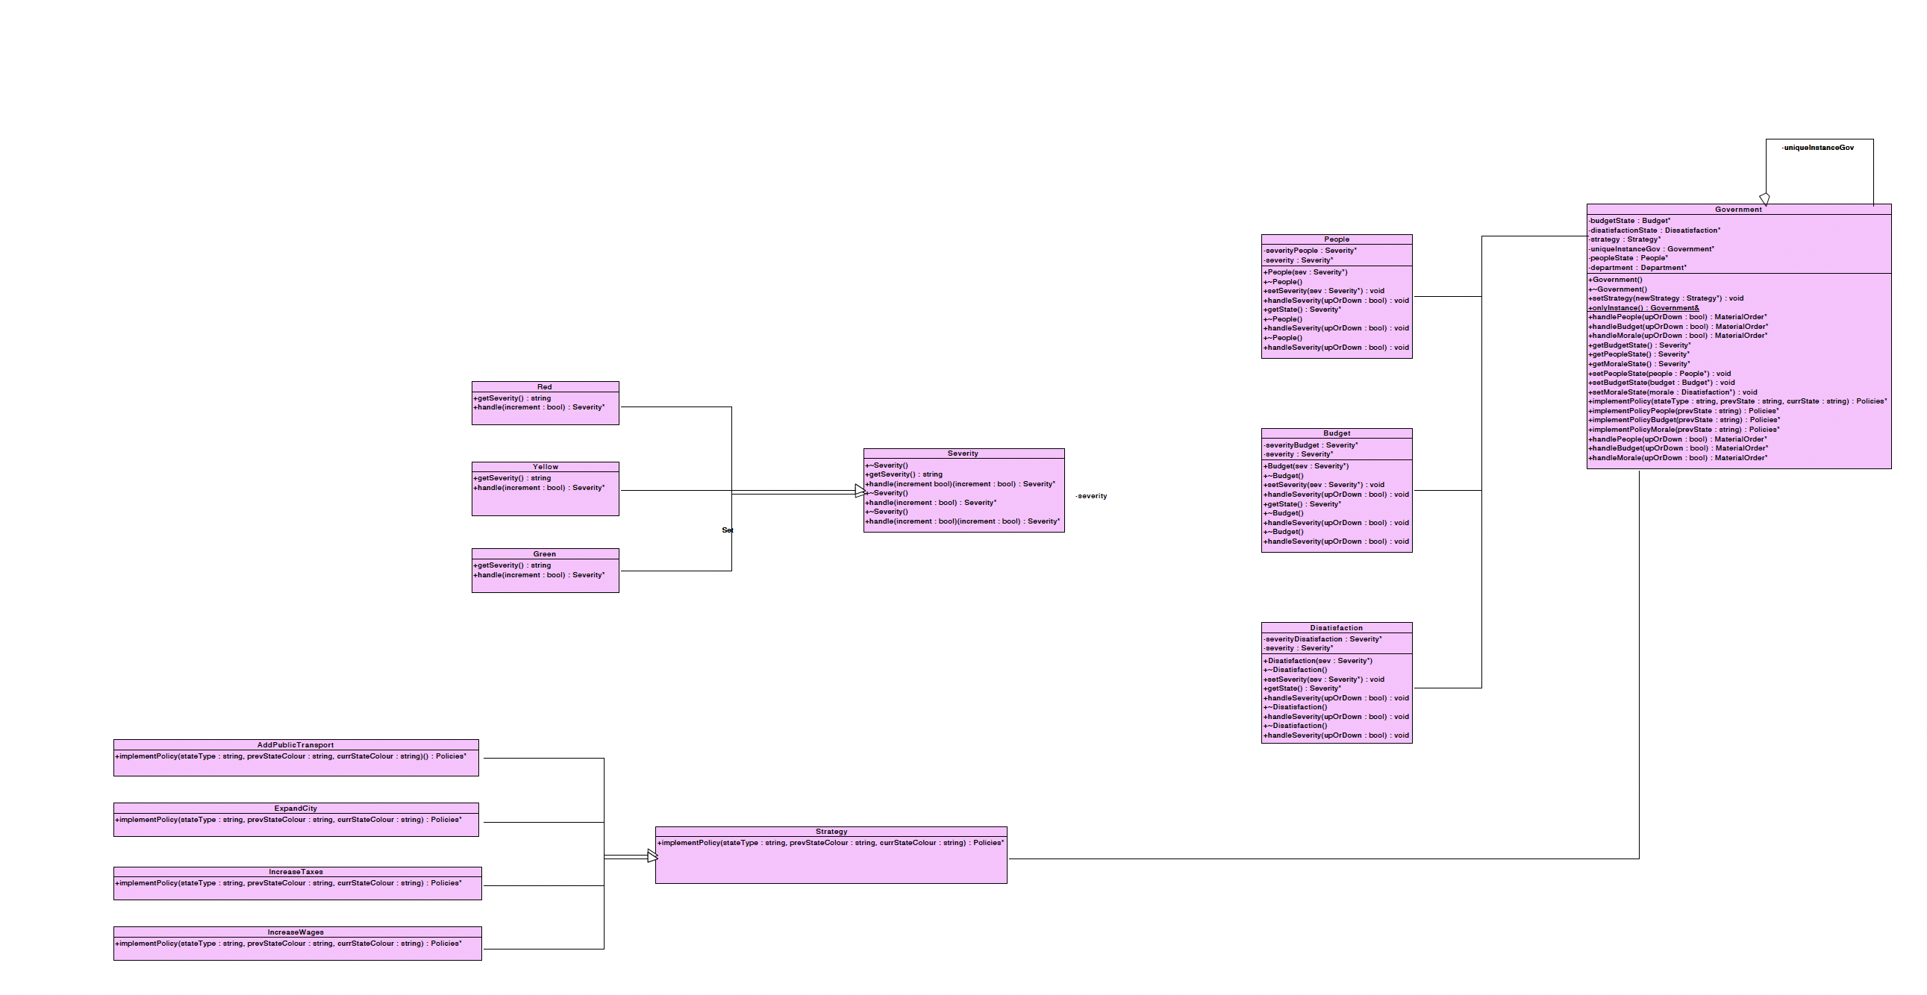
Strategy and state
Integrated the State and Strategy Design Patterns to guide government decision-making and determine optimal actions.
The State Pattern assesses three key factors: population needs, budget constraints, and morale levels.
Based on the severity of these conditions, the Strategy Pattern formulates appropriate policies for departmental action and response.
Notes:
Who: Saskia
Time: 60 sec

Slide 12
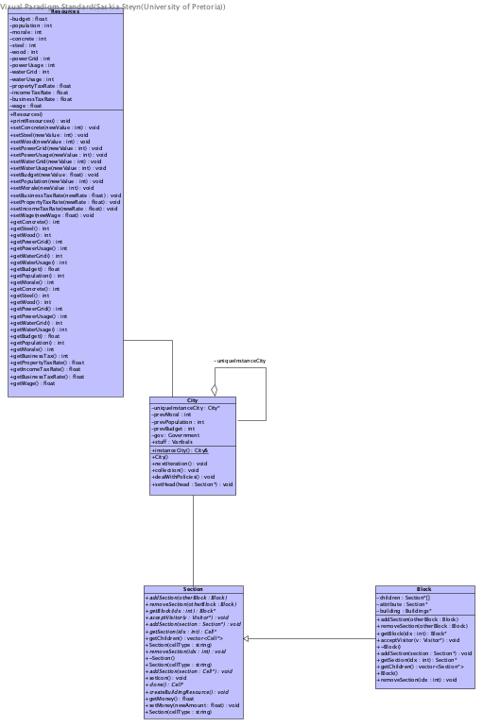
Composite
Implemented the Composite Design Pattern to organize city blocks, each containing multiple buildings, within a hierarchical tree structure.
Ensured new buildings are placed in the appropriate block, maintaining an organized and scalable layout.
Notes:
Who: Gay Stefan
Time: 30 sec

Slide 13
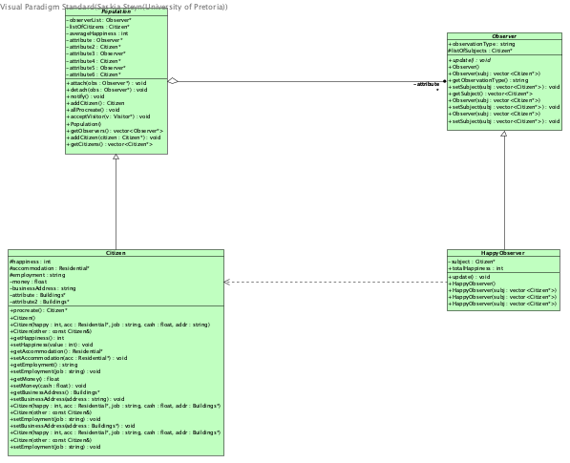
Observer
Leveraged the Observer Design Pattern to monitor citizen happiness and income levels in real-time.
Automatically notifies the city system of any changes, prompting recalculations and updates to stored values accordingly.
Notes:
Who: Raven
Time: 30 sec

Slide 14
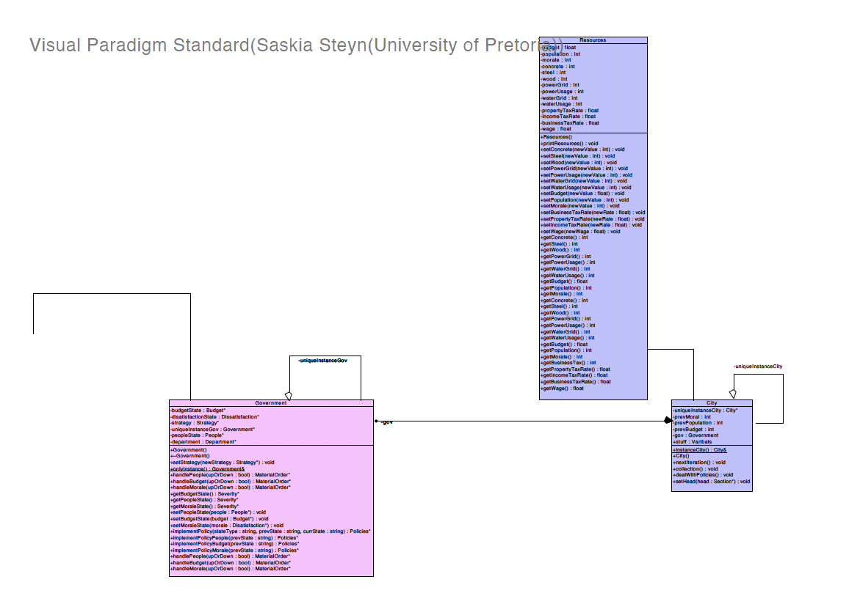
Command
Utilized the Command Design Pattern to modify stored values within the city system, such as morale and tax rates.
Ensures changes are executed in a controlled and consistent manner.
Notes:
Who: Saskia
Time: 30 sec

Slide 15
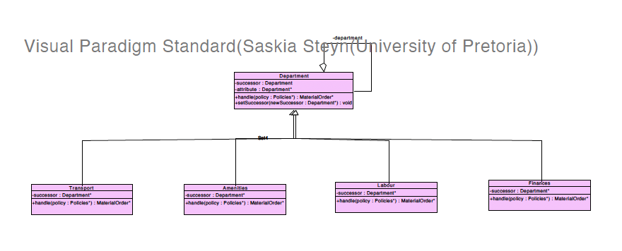
Chain of responsibility
Applied the Chain of Responsibility Design Pattern to process various policy directives generated by the Strategy Pattern.
Designated each department to handle specific policy types and communicate necessary adjustments to improve city conditions.
Notes:
Who: Saskia
Time: 30 sec

Slide 16
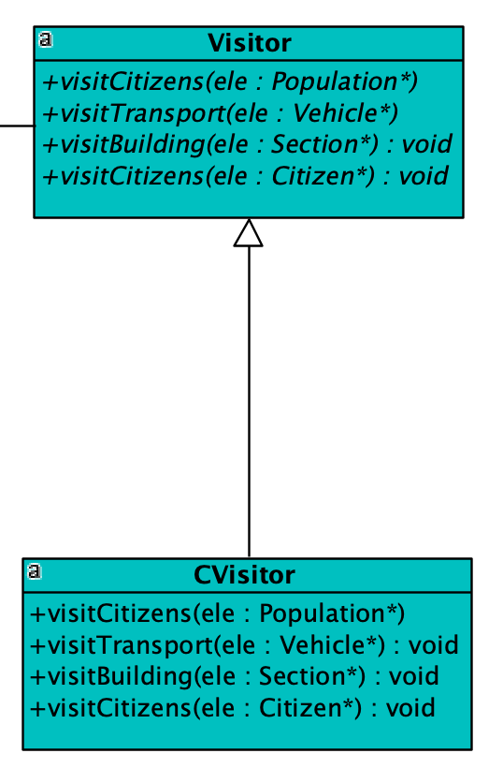
Visitor
Employed the Visitor Design Pattern to gather income data across different entities.
Aggregated collected income and transmitted it to the city system for income tax processing.
Notes:
Who: Gay Stefan
Time: 30 sec

Slide 17
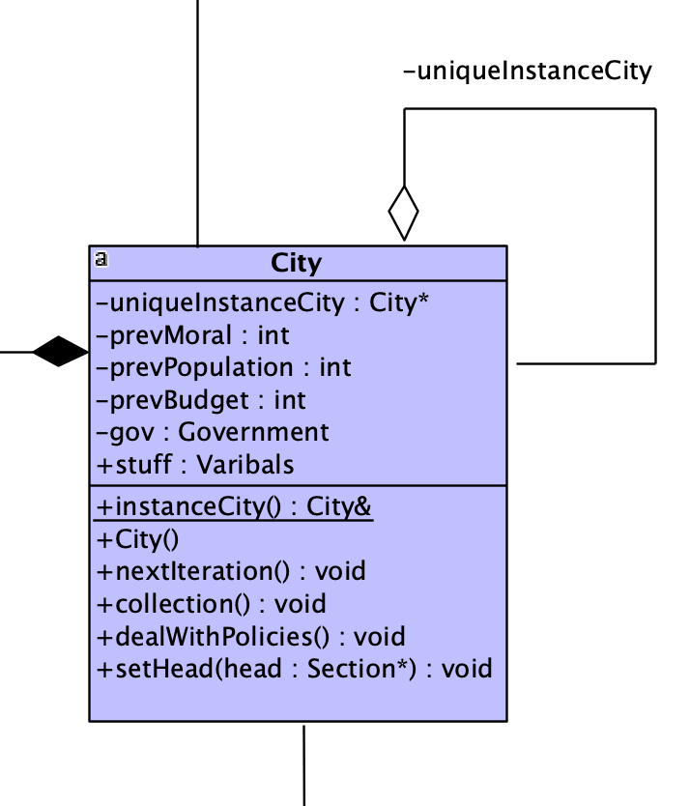
Singleton
Implemented the Singleton Design Pattern for the City and Government classes to ensure a single instance of each.
Prevented the creation of multiple instances, maintaining centralized control and consistency across the system.
Notes:
Who: Johan
Time: 30 sec

Slide 18
Github and Doxygen

Slide 19
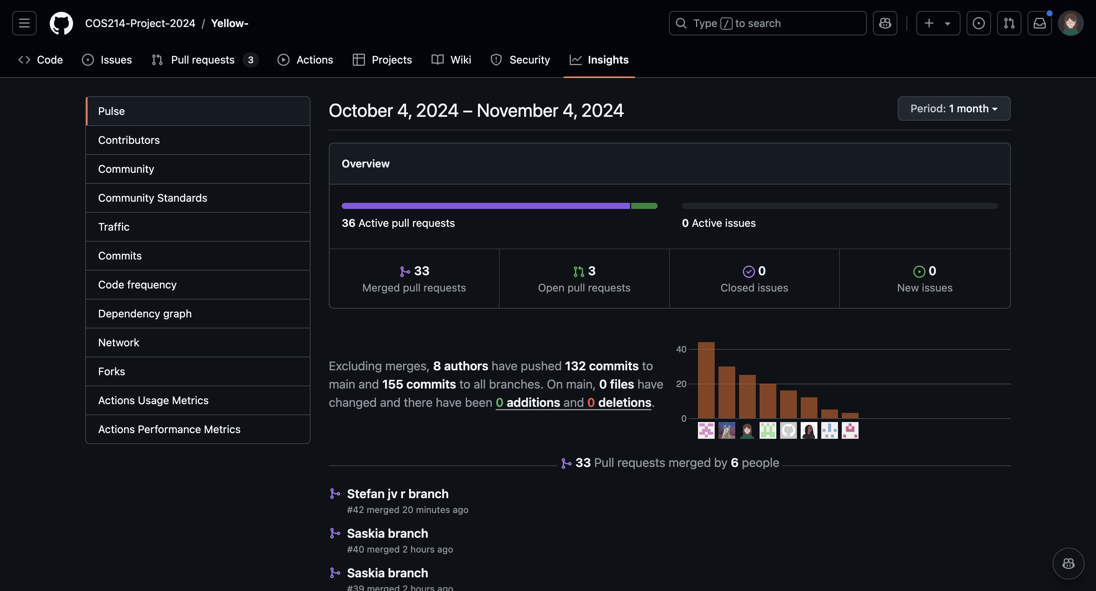
github
Notes:
Who: Stefan
Time: 60 secs

Slide 20
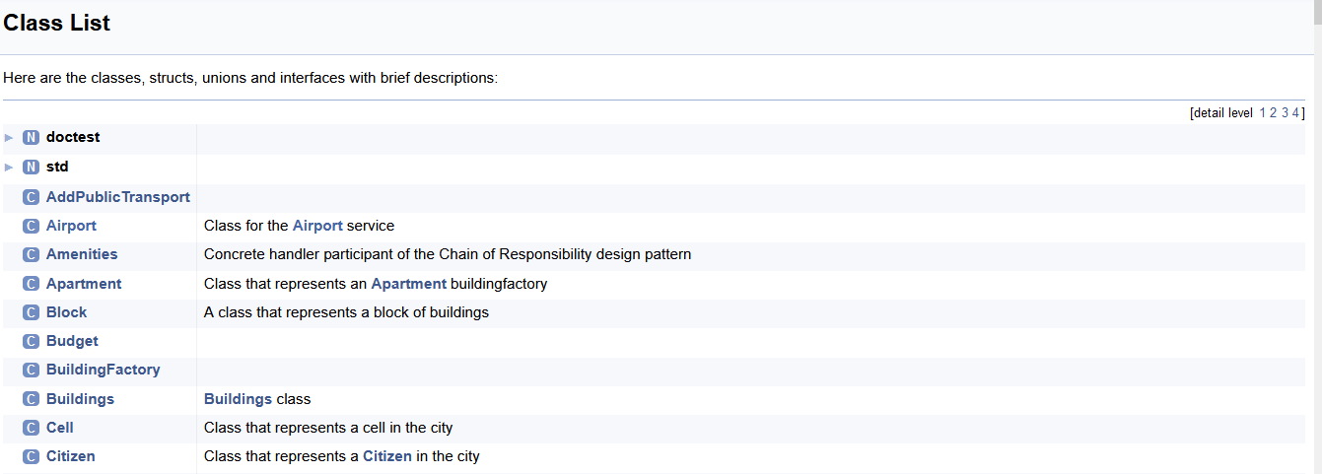
doxygen
Notes:
Who: Daniel
Time: 60 sec

Slide 21
tests

Slide 22
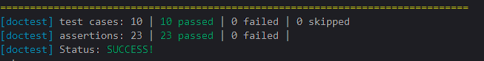
Unit Test
Notes:
Who: Johan
Time: 30 sec

Slide 23
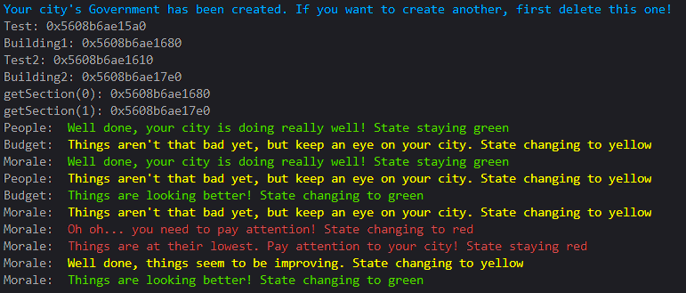
Integration tests
Notes:
Who: Johan
Time: 30 sec

Slide 24
Conclusion

Slide 25
Conclusion
The City Builder Simulation project successfully met all requirements, showcasing the effective use of software design patterns for a scalable and maintainable system. Through building management, citizen tracking, and government decision-making, we created a realistic urban environment. The project included UML diagrams, modular C++ code, and thorough documentation, fulfilling technical and educational goals while preparing us for future software engineering challenges.
Notes:
Who: Raven
Time: 20 sec

Slide 26
Live Demo

